Slide 1
Plant Disease Detection
AI HACK DAYS
25 JAN 2025
Revolutionizing Agriculture with DeepLearning & Convolutional Neural Network
GOLDEN DAWN
N.SAKETH CHAKRAVARTHY
RAJA VARUN
RIBHU S

Slide 2

Problem Statement
Difficulty in identifying crop diseases and pests accurately in real-time.
Limited access to expert agricultural advice for small-scale farmers.
Inadequate integration of plant images, soil data, and weather trends to diagnose issues effectively.
Delay in implementing effective control measures, leading to crop loss and reduced yield.

Slide 3
Project objective
Develop a Convolutional Neural Network (CNN)-based web application for accurate crop disease and pest detection using image classification.
Integrate soil data analysis and weather trends to provide holistic, real-time insights.
Provides specific remedies and recommendations to farmers.

Slide 4
Scope of the Project
Key Focus Areas:
Use soil analysis algorithms and weather trend predictions to evaluate nutrient levels and deficiencies.
Provide real-time, specific recommendations for disease and pest management.
Limitations:
Internet connectivity is essential for processing and real-time insights.
May initially cover a limited range of crops, pests, and diseases, which can be expanded over time.

Slide 5
Innovation and Creativity
Unique Concept
Integration of a chatbot feature powered by AI, allowing users to ask questions and receive real-time assistance about plant diseases and pest management.
Support for local regional languages to make the platform accessible and user-friendly for farmers from diverse linguistic backgrounds.
Combines disease detection, soil analysis, and weather trends into a single, comprehensive platform.

Slide 6
Inspiration
Empowering farmers with real-time, expert-level insights to improve crop yield and minimize losses.
Addressing the gap in technology adoption for small-scale farmers due to language barriers and lack of accessibility.

Slide 7
Creative Features
Creative Features
Multilingual Chatbox: Enables farmers to communicate in their preferred regional language and get instant support, making the platform inclusive.
User-Friendly Interface: Designed for farmers with limited technical expertise, ensuring ease of use.
Real-Time Monitoring: Allows farmers to closely monitor crop health and receive continuous updates.
Localized Insights: Recommendations tailored to specific crops, regional weather trends, and soil data.
Sustainability Focus: Offers a variety of remedies (natural, organic, and chemical) for flexible and sustainable farming practices.

Slide 8
Technical Implementation Overview
Technologies Used:-
Programming Language: Python
Frameworks and Libraries: TensorFlow, Keras, Matplotlib, NumPy
Dataset Source: Kaggle: Plant Village Dataset
Tools: Jupyter Notebook, IPython
Frontend: Web Interface: HTML, CSS, JavaScript, StreamLit
Backend: Flask, StreamLit

Slide 9
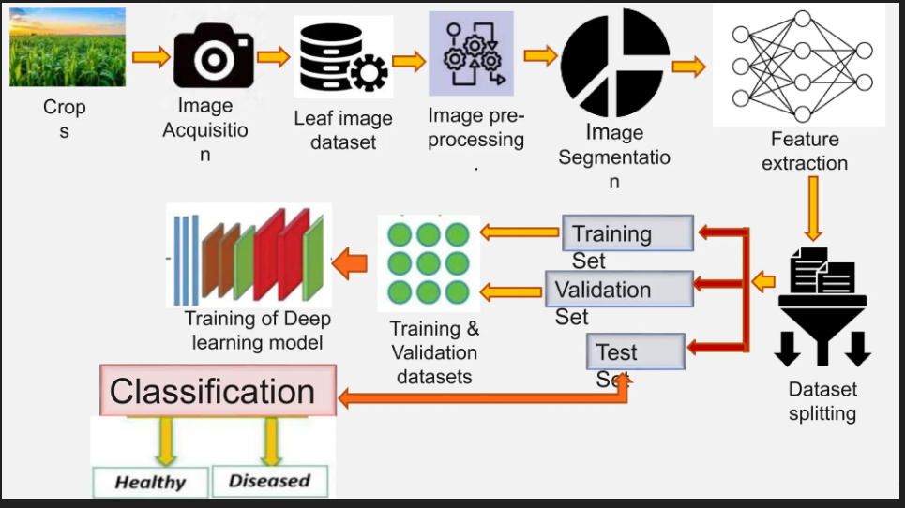
System Architecture
System Flow Diagram:
Input Data
Preprocessing
Dataset Splitting
Model Building
Training
Evaluation.
Prediction/Inference

Slide 10
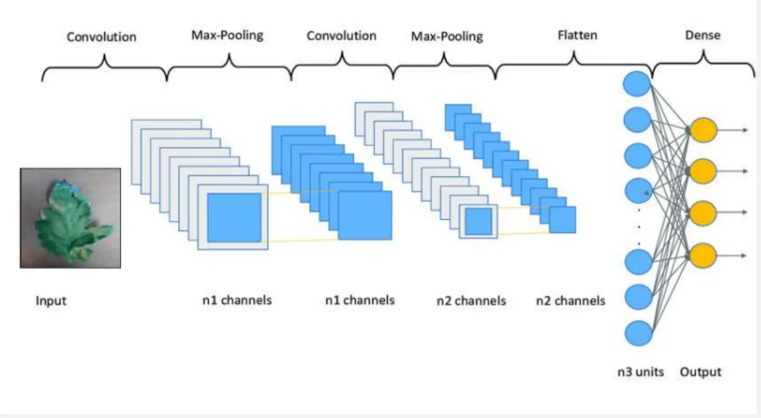
Key Components
Image Preprocessing:
Resize to 256x256
Normalize pixel values
Data augmentation for improved accuracy
Model Architecture:
Convolutional Neural Network (CNN)
Activation Functions: ReLU and SoftMax
Layers: 5 Convolutional,1 Dense Output
Optimization:
Optimizer: Adam
Loss Function: Sparse Categorical Cross entropy
CNN Layers

Slide 11
Detailed Technical Implementation
Model Used:
Convolutional Neural Network (CNN)
Designed for image classification tasks.
Extracts features from images using convolutional layers.
Steps in the Process:
Data Preprocessing:
Resizing, normalization, and augmentation to increase dataset variability.
Split dataset into training, validation, and testing sets.
Model Training:
CNN with multiple layers (Convolution, Pooling, Dense).
Optimization using Adam Optimizer.
Loss function: Categorical Crossentropy for multi-class classification.
Prediction Pipeline:
Input image processed through the model.
Output: Disease classification with confidence score.

Slide 12
Challenges and Solutions
Challenge 1: Dataset Imbalance
Problem: Uneven distribution of images for different disease categories.
Solution: Applied data augmentation techniques such as flipping, rotation, and scaling to balance the dataset.
Challenge 2: Overfitting during Training
Problem: Model performed well on training data but poorly on validation data.
Solution:
Introduced Dropout layers to prevent overfitting and used Early Stopping to halt training when validation performance ceased to improve
Challenge 3: Model Deployment
Problem: Integrating the trained model into a real-world web-based system.
Solution:
Used Flask/StreamLit for backend API.
Optimized the model using TensorFlow Lite for faster inference.

Slide 13
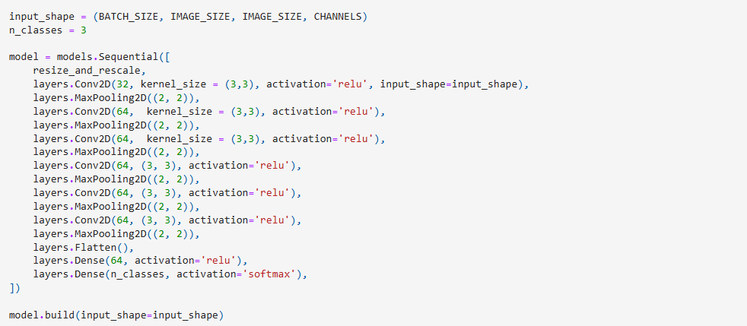
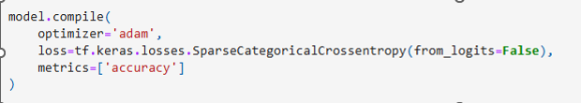
Code Architecture
Building the CNN layers
Compiling the model using adam optimizer

Slide 14
Feasibility and Real-World Application
Real-World Problem Solved:
Plant Disease Detection: Identifies plant diseases early, allowing for timely interventions.
Agricultural Efficiency: Reduces the need for manual inspections, saving time and labor.
Practical Application:
Industry Adoption: Can be integrated into precision agriculture tools, aiding farmers in diagnosing plant health quickly and accurately.
Scalability: The model can be scaled for large-scale agricultural settings with diverse crops.

Slide 15
Feasibility and Real-World Application
Feasibility:
Deployment Considerations: Cloud or on-device deployment for real-time analysis.
Resource Efficiency: Optimized for minimal computational resources, making it viable for mobile or edge devices.
User/Market Impact:
Economic Value: Reduces crop loss and improves yield by detecting diseases early.
Environmental Benefit: Encourages sustainable farming by minimizing pesticide use through targeted treatment.

Slide 16
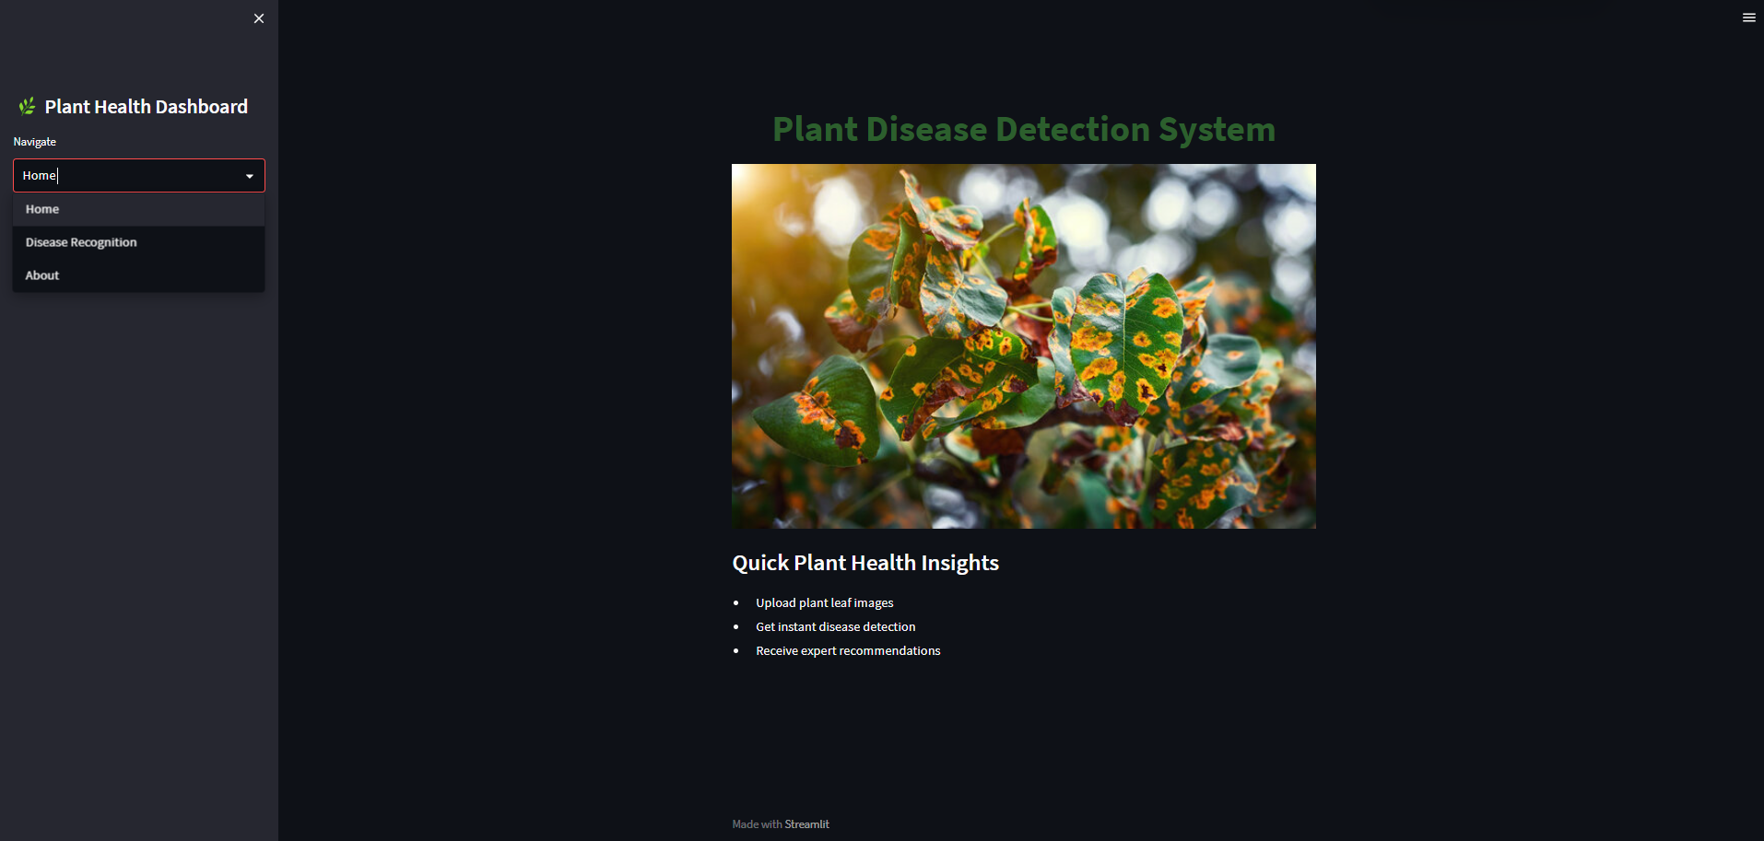
Home Page

Slide 17
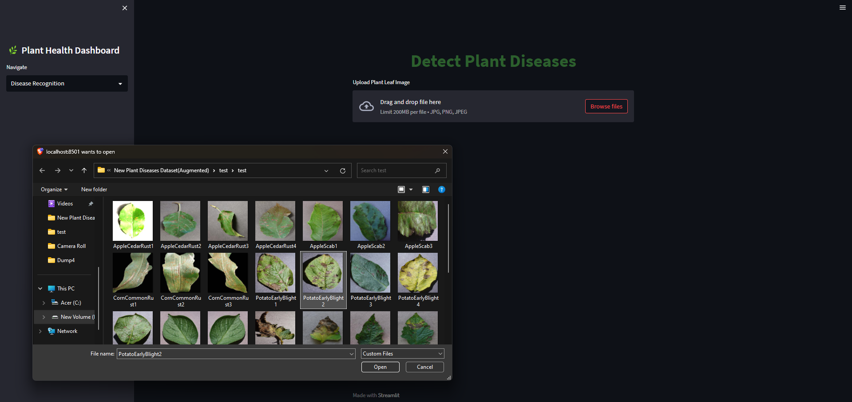
Disease Detection

Slide 18
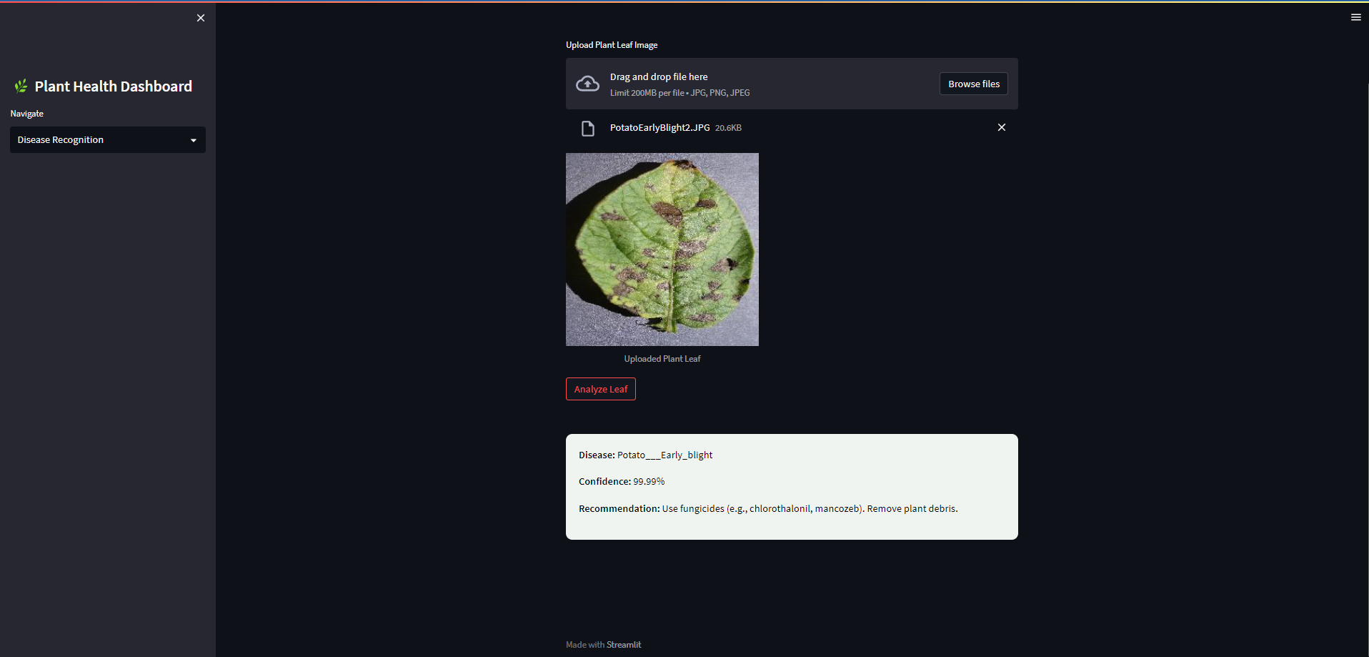
Result

Slide 19
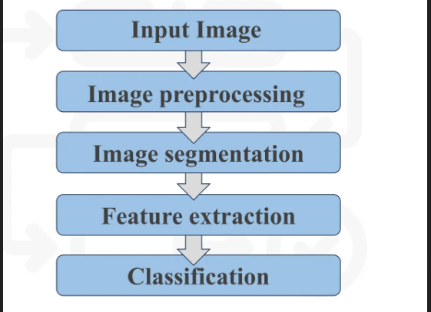
Project demo
Functionality Walkthrough:
Image Upload: Users upload plant images for disease detection.
Prediction Output: System processes the image and provides a disease prediction with confidence scores.
Soil Data Integration: Includes soil parameters for more accurate diagnosis (if implemented).
Chatbox: Allows users to chat with the system, get plant care advice, or troubleshoot issues.

Slide 20
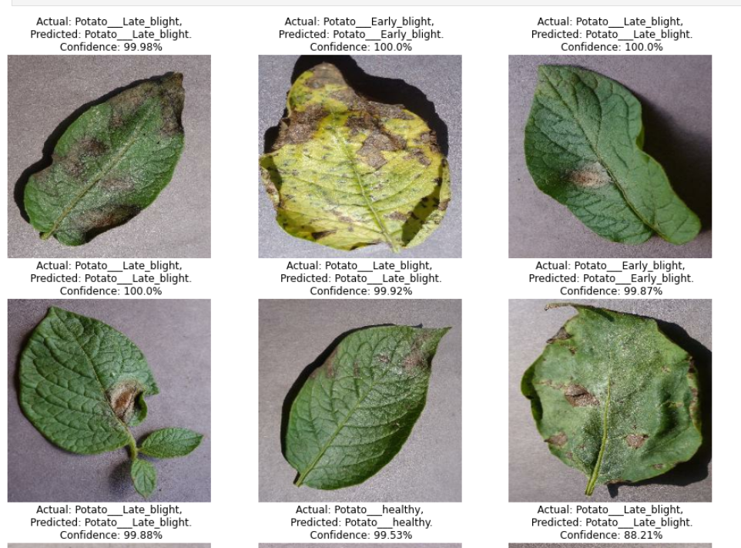
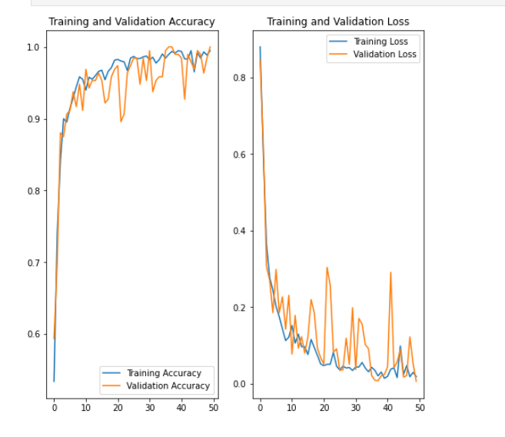
Performance Metrics:-

Slide 21
Future Work and Improvements
Limitations:
Limited dataset for some plant species and diseases.
Accuracy of detection can vary under different environmental conditions.
Computational requirements for training large models.
Improvements:
Expand the dataset to include more plant species and disease types.
Enhance model accuracy by implementing more advanced algorithms or fine-tuning hyperparameters.
Integrate additional environmental factors such as weather conditions for better real-world applicability.

Slide 22
Future Work and Improvements
Long-Term Vision:
Implement the system on mobile platforms for real-time, on-field disease and nutrient deficiency detection.
Collaboration with agriculture industries for widespread adoption.
Develop AI-powered predictive analytics for proactive plant care
Multi-Purpose Use:
Apart from plant disease identification, the system can also be applied for identifying and classifying nutrient deficiencies in plant leaves.

Slide 23
Conclusion
Summary:
Successfully developed a system for plant disease detection using image classification and soil data.
Integrated advanced techniques like dropout layers, early stopping, and CNNs for improved performance.
Focus on scalability and real-world applications in agriculture.
Impact:
Can significantly improve plant health management, reduce crop loss, and enhance agricultural productivity.
Provides farmers with a tool to detect diseases early and efficiently, enabling timely interventions.

Slide 24
Contact Us
Our Contact info:
Ribhu S
Roll no: 23261A6752
Email: sribhu_csd236752@mgit.ac.in
Phone: 9701389782
Saketh
Roll no: 23261A6744
Email: nsakethchakravarthy_csd236744@mgit.ac.in
Phone: 7021316625
Varun
Roll no: 23261A6748
Email: rvarun_csd236748@mgit.ac.in
Phone: 9849106126

